Slide 1



Slide 2
GitHub Introduction
What is GitHub ?
GitHub is a web-based Git or version control repository and Internet hosting service.
It offers all of the distributed version control and source code management (SCM) functionality of Git as well as adding its own features.
It provides access control and several collaboration features such as bug tracking, feature requests, task management, and wikis for every project.

Slide 3
GitHub Introduction
GitHub offers both plans for private and free repositories on the same account which are commonly used to host open-source software projects.
As of April 2016, GitHub reports having more than 14 million users and more than 85.5 million repositories, making it the largest host of source code in the world.

Slide 4
GitHub Introduction
The trademark mascot of GitHub is Octocat, an anthropomorphized cat with cephalopod limbs.
Git is a distributed revision control and source code management system with an emphasis on speed. Git was initially designed and developed by Linus Torvalds for Linux kernel development. Git is a free software distributed under the terms of the GNU General Public License version 2.

Slide 5
GitHub Introduction
Version Control System
Version Control System (VCS) is a software that helps software developers to work together and maintain a complete history of their work.
Listed below are the functions of a VCS:
Allows developers to work simultaneously.
Does not allow overwriting each other’s changes.
Maintains a history of every version.

Slide 6
GitHub Introduction
Following are the types of VCS:
Centralized version control system (CVCS).
Distributed/Decentralized version control system (DVCS).

Slide 7
GitHub Introduction
Distributed Version Control System
Centralized version control system (CVCS) uses a central server to store all files and enables team collaboration.
But the major drawback of CVCS is its single point of failure, i.e., failure of the central server.
Unfortunately, if the central server goes down for an hour, then during that hour, no one can collaborate at all.

Slide 8
GitHub Introduction
And even in a worst case, if the disk of the central server gets corrupted and proper backup has not been taken, then you will lose the entire history of the project.
Here, distributed version control system (DVCS) comes into picture.
DVCS clients not only check out the latest snapshot of the directory but they also fully mirror the repository.

Slide 9
GitHub Introduction
If the server goes down, then the repository from any client can be copied back to the server to restore it.
Every checkout is a full backup of the repository. Git does not rely on the central server and that is why you can perform many operations when you are offline.
You can commit changes, create branches, view logs, and perform other operations when you are offline. You require network connection only to publish your changes and take the latest changes.

Slide 10
Advantages of Git
Advantages of Git
Free and open source
Git is released under GPL’s open source license. It is available freely over the internet.
You can use Git to manage property projects without paying a single penny.
As it is an open source, you can download its source code and also perform changes according to your requirements.

Slide 11
Advantages of Git
Fast and small
As most of the operations are performed locally, it gives a huge benefit in terms of speed.
Git does not rely on the central server; that is why, there is no need to interact with the remote server for every operation.
The core part of Git is written in C, which avoids runtime overheads associated with other high-level languages.

Slide 12
Advantages of Git
Though Git mirrors entire repository, the size of the data on the client side is small.
This illustrates the efficiency of Git at compressing and storing data on the client side.
Implicit backup
The chances of losing data are very rare when there are multiple copies of it.
Data present on any client side mirrors the repository, hence it can be used in the event of a crash or disk corruption.

Slide 13
Advantages of Git
Security
Git uses a common cryptographic hash function called secure hash function (SHA1), to name and identify objects within its database.
Every file and commit is check-summed and retrieved by its checksum at the time of checkout.
It implies that, it is impossible to change file, date, and commit message and any other data from the Git database without knowing Git.

Slide 14
Advantages of Git
No need of powerful hardware
In case of CVCS, the central server needs to be powerful enough to serve requests of the entire team.
For smaller teams, it is not an issue, but as the team size grows, the hardware limitations of the server can be a performance bottleneck.
In case of DVCS, developers don’t interact with the server unless they need to push or pull changes.

Slide 15
Advantages of Git
All the heavy lifting happens on the client side, so the server hardware can be very simple indeed.
Easier branching
CVCS uses cheap copy mechanism, If we create a new branch, it will copy all the codes to the new branch, so it is time-consuming and not efficient.
Also, deletion and merging of branches in CVCS is complicated and time-consuming. But branch management with Git is very simple. It takes only a few seconds to create, delete, and merge branches.

Slide 16
DVCS Terminologies
DVCS Terminologies
Local Repository
Every VCS tool provides a private workplace as a working copy.
Developers make changes in their private workplace and after commit, these changes become a part of the repository.
Git takes it one step further by providing them a private copy of the whole repository.

Slide 17
DVCS Terminologies
Users can perform many operations with this repository such as add file, remove file, rename file, move file, commit changes, and many more.
Working Directory and Staging Area or Index
The working directory is the place where files are checked out.
In other CVCS, developers generally make modifications and commit their changes directly to the repository. But Git uses a different strategy.

Slide 18
DVCS Terminologies
Git doesn’t track each and every modified file. Whenever you do commit an operation, Git looks for the files present in the staging area.
Only those files present in the staging area are considered for commit and not all the modified files.

Slide 19
GitHub
GitHub
Development of the GitHub platform began on 1 October 2007.
The site was launched in April 2008 by Tom Preston-Werner, Chris Wanstrath, and PJ Hyett after it had been made available for a few months prior as a beta release.
Projects on GitHub can be accessed and manipulated using the standard Git command-line interface and all of the standard Git commands work with it.

Slide 20
GitHub
GitHub also allows registered and non-registered users to browse public repositories on the site.
Multiple desktop clients and Git plugins have also been created by GitHub and other third parties that integrate with the platform.
The site provides social networking-like functions such as feeds, followers, wikis (using wiki software called Gollum) and a social network graph to display

Slide 21
GitHub
how developers work on their versions ("forks") of a repository and what fork (and branch within that fork) is newest.
A user must create an account in order to contribute content to the site, but public repositories can be browsed and downloaded by anyone.
With a registered user account, users are able to discuss, manage, create repositories, submit contributions to others' repositories, and review changes to code.

Slide 22
GitHub
The software that runs GitHub was written using Ruby on Rails and Erlang by GitHub, Inc. developers Chris Wanstrath,PJ Hyett, and Tom Preston-Werner.

Slide 23
Scope
Scope
GitHub is mostly used for code.
In addition to source code, GitHub supports the following formats and features:
Documentation, including automatically rendered README files in a variety of Markdown-like file formats (see README files on GitHub)
Issue tracking (including feature requests) with labels, milestones, assignees and a search engine

Slide 24
Scope
Wikis
Pull requests with code review and comments
Commits history
Graphs: pulse, contributors, commits, code frequency, punch card, network, members
Integrations Directory
Unified and split diffs
Email notifications

Slide 25
Scope
Option to subscribe someone to notifications by @ mentioning them.
Emojis
GitHub Pages: small websites can be hosted from public repositories on GitHub. The URL format is http://username.github.io.
Nested task-lists within files
Visualization of geospatial data

Slide 26
Scope
3D render files that can be previewed using a new integrated STL file viewer that displays the files on a "3D canvas". The viewer is powered by WebGL and Three.js.
Photoshop's native PSD format can be previewed and compared to previous versions of the same file.

Slide 27
GitHub - Account Setup and Configuration
GitHub - Account Setup and Configuration
GitHub is the single largest host for Git repositories, and is the central point of collaboration for millions of developers and projects.
A large percentage of all Git repositories are hosted on GitHub, and many open-source projects use it for Git hosting, issue tracking, code review, and other things.
So while it’s not a direct part of the Git open source project, there’s a good chance that you’ll want or

Slide 28
GitHub - Account Setup and Configuration
need to interact with GitHub at some point while using Git professionally.
In this section We’ll cover signing up for and managing an account, creating and using Git repositories, common workflows to contribute to projects and to accept contributions to yours, GitHub’s programmatic interface and lots of little tips to make your life easier in general.

Slide 29
GitHub - Account Setup and Configuration
If you are not interested in using GitHub to host your own projects or to collaborate with other projects that are hosted on GitHub, you can safely skip to Git Tools.

Slide 30
GitHub - Account Setup and Configuration
Account Setup and Configuration
The first thing you need to do is set up a free user account.
Simply visit https://github.com, choose a user name that isn’t already taken, provide an email address and a password, and click the big green “Sign up for GitHub” button.

Slide 31
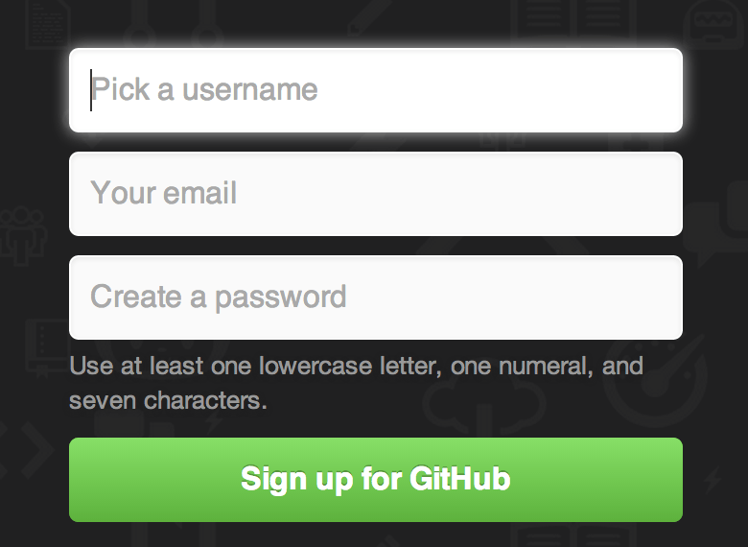
GitHub - Account Setup and Configuration

Slide 32
GitHub - Account Setup and Configuration
The next thing you’ll see is the pricing page for upgraded plans, but it’s safe to ignore this for now. GitHub will send you an email to verify the address you provided.
Clicking the Octocat logo at the top-left of the screen will take you to your dashboard page. You’re now ready to use GitHub.

Slide 33
GitHub - Account Setup and Configuration
SSH Access
As of right now, you’re fully able to connect with Git repositories using the https:// protocol, authenticating with the username and password you just set up.
However, to simply clone public projects, you don’t even need to sign up - the account we just created comes into play when we fork projects and push to our forks a bit later.

Slide 34
GitHub - Account Setup and Configuration
Your Email Addresses
The way that GitHub maps your Git commits to your user is by email address.
If you use multiple email addresses in your commits and you want GitHub to link them up properly, you need to add all the email addresses you have used to the Emails section of the admin section.

Slide 35
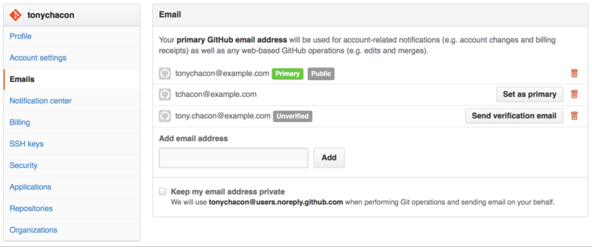
GitHub - Account Setup and Configuration

Slide 36
GitHub - Account Setup and Configuration
In Add email addresses we can see some of the different states that are possible.
The top address is verified and set as the primary address, meaning that is where you’ll get any notifications and receipts.
The second address is verified and so can be set as the primary if you wish to switch them.

Slide 37
GitHub - Account Setup and Configuration
The final address is unverified, meaning that you can’t make it your primary address.
If GitHub sees any of these in commit messages in any repository on the site, it will be linked to your user now.

Slide 38
Git Basics
Git Basics
So, what is Git in a nutshell? This is an important section to absorb, because if you understand what Git is and the fundamentals of how it works, then using Git effectively will probably be much easier for you.
As you learn Git, try to clear your mind of the things you may know about other VCSs, such as Subversion and Perforce; doing so will help you avoid subtle confusion when using the tool.

Slide 39
Git Basics
Git stores and thinks about information much differently than these other systems, even though the user interface is fairly similar, and understanding those differences will help prevent you from becoming confused while using it.

Slide 40
Git Basics
Snapshots, Not Differences
The major difference between Git and any other VCS (Subversion and friends included) is the way Git thinks about its data. Conceptually, most other systems store information as a list of file-based changes.
These systems (CVS, Subversion, Perforce, Bazaar, and so on) think of the information they keep as a set of files and the changes made to each file over time.

Slide 41
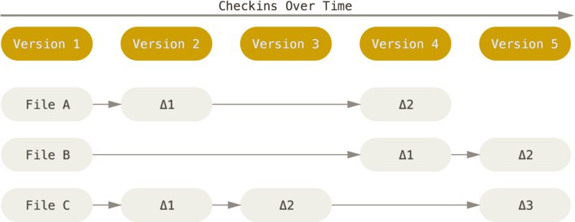
Git Basics

Slide 42
Git Basics
Git doesn’t think of or store its data this way. Instead, Git thinks of its data more like a set of snapshots of a miniature filesystem.
Every time you commit, or save the state of your project in Git, it basically takes a picture of what all your files look like at that moment and stores a reference to that snapshot.

Slide 43
Git Basics
To be efficient, if files have not changed, Git doesn’t store the file again, just a link to the previous identical file it has already stored.
Git thinks about its data more like a stream of snapshots.

Slide 44
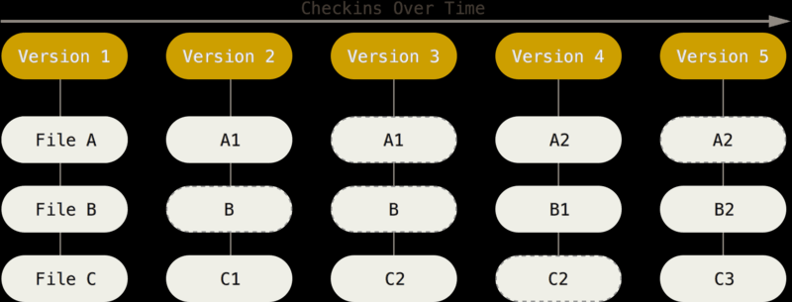
Git Basics

Slide 45
Git Basics
This is an important distinction between Git and nearly all other VCSs.
It makes Git reconsider almost every aspect of version control that most other systems copied from the previous generation.
This makes Git more like a mini filesystem with some incredibly powerful tools built on top of it, rather than simply a VCS.

Slide 46
Git Basics
Nearly Every Operation Is Local
Most operations in Git only need local files and resources to operate – generally no information is needed from another computer on your network.
If you’re used to a CVCS where most operations have that network latency overhead, this aspect of Git will make you think that the gods of speed have blessed Git with unworldly powers.
Because you have the entire history of the project right there on your local disk, most operations seem

Slide 47
Git Basics
almost instantaneous.
For example, to browse the history of the project, Git doesn’t need to go out to the server to get the history and display it for you – it simply reads it directly from your local database.
This means you see the project history almost instantly.
If you want to see the changes introduced between the current version of a file and the file a month ago, Git can look up the file a month ago and do a local

Slide 48
Git Basics
difference calculation, instead of having to either ask a remote server to do it or pull an older version of the file from the remote server to do it locally.
This also means that there is very little you can’t do if you’re offline or off VPN. If you get on an airplane or a train and want to do a little work, you can commit happily until you get to a network connection to upload. If you go home and can’t get your VPN client working properly, you can still work.

Slide 49
Git Basics
In many other systems, doing so is either impossible or painful. In Perforce, for example, you can’t do much when you aren’t connected to the server; and in Subversion and CVS, you can edit files, but you can’t commit changes to your database (because your database is offline).
This may not seem like a huge deal, but you may be surprised what a big difference it can make.

Slide 50
Git Basics
Git Has Integrity
Everything in Git is check-summed before it is stored and is then referred to by that checksum.
This means it’s impossible to change the contents of any file or directory without Git knowing about it. This functionality is built into Git at the lowest levels and is integral to its philosophy.
You can’t lose information in transit or get file corruption without Git being able to detect it.

Slide 51
Git Basics
The mechanism that Git uses for this checksumming is called a SHA-1 hash.
This is a 40-character string composed of hexadecimal characters (0–9 and a–f) and calculated based on the contents of a file or directory structure in Git. A SHA-1 hash looks something like this:
24b9da6552252987aa493b52f8696cd6d3b00373

Slide 52
Git Basics
You will see these hash values all over the place in Git because it uses them so much.
In fact, Git stores everything in its database not by file name but by the hash value of its contents.

Slide 53
Git Basics
Git Generally Only Adds Data
When you do actions in Git, nearly all of them only add data to the Git database.
It is hard to get the system to do anything that is not undoable or to make it erase data in any way.
As in any VCS, you can lose or mess up changes you haven’t committed yet; but after you commit a snapshot into Git, it is very difficult to lose, especially if you regularly push your database to another repository.

Slide 54
Git Basics
This makes using Git a joy because we know we can experiment without the danger of severely screwing things up

Slide 55
Git Basics
The Three States
Now, pay attention. This is the main thing to remember about Git if you want the rest of your learning process to go smoothly.
Git has three main states that your files can reside in: committed, modified, and staged. Committed means that the data is safely stored in your local database. Modified means that you have changed the file but have not committed it to your database yet.

Slide 56
Git Basics
Staged means that you have marked a modified file in its current version to go into your next commit snapshot.
This leads us to the three main sections of a Git project: the Git directory, the working tree, and the staging area.

Slide 57
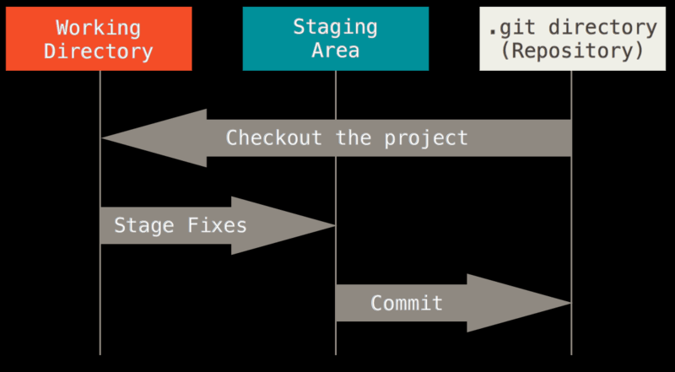
Git Basics

Slide 58
Git Basics
The Git directory is where Git stores the metadata and object database for your project.
This is the most important part of Git, and it is what is copied when you clone a repository from another computer.
The working tree is a single checkout of one version of the project.
These files are pulled out of the compressed database in the Git directory and placed on disk for you to use or modify.

Slide 59
Git Basics
The staging area is a file, generally contained in your Git directory, that stores information about what will go into your next commit.
It’s sometimes referred to as the “index”, but it’s also common to refer to it as the staging area.
The basic Git workflow goes something like this:
You modify files in your working tree.
You stage the files, adding snapshots of them to your staging area.

Slide 60
Git Basics
You do a commit, which takes the files as they are in the staging area and stores that snapshot permanently to your Git directory.
If a particular version of a file is in the Git directory, it’s considered committed. If it has been modified and was added to the staging area, it is staged. And if it was changed since it was checked out but has not been staged, it is modified.

